Slide 1

Storm Chasers
Dan, Suresh, Gabriel, Sasi, Brandon, Abiel

Slide 2






W O R K C Y C L E
03
Machine Learning
06
Logistic Regression
04
HTML & CSS
01
Tableau
Window to this world
Data Search
Data visualization and analytics
Used BigQuery from Google Cloud Services
02
Data Cleansing
05
Flask
Pandas helped here
Technology to stick all these

Slide 3

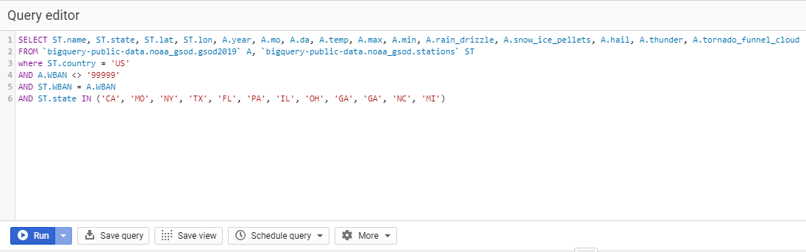
Finding the data
Kaggle data source let us to Google Cloud Services.
Pulled data for each year since 1990.
Over 21 million rows of data , is narrowed to 11 states resulting in 8 million rows.
Notes:
WBAN- Weather-Bureau-Army-Navy
BigQuery query for each year

Slide 4


Data Cleansing
Combine tables from each year for 29 years.
Removed null values.
Limited data to MO for Machine Learning.
Exported Data to SQLite.
Notes:
Data was fairly clean since it was all from a similar site

Slide 5

Machine Learning
Regression model
Latitude and longitude is used to identify location.
Month and Day to narrow down.
To predict Rainfall on any given day.
Accuracy is 70%
Saved the model using joblib module

Slide 6

Tableau
Used Tableau to map weather stations in all 11 states.
8 millions rows in total
300k in Missouri alone
Lots of calculated fields.
Trends

Slide 7

Flask
Connected the SQLite database
Loaded Machine Learning Model
Created endpoints to render website
Retrieved user data from request object
Used D3 Javascript to update Weather Card

Slide 8


HTML & CSS
Created web pages to display our findings.
Embedded Tableau.
Embedded Machine learning interactive model.
Worked with CSS for fonts and display.

Slide 9

DEMO

